Slide 1
Chapter 3 – Cell Structure and Function

Slide 2
3.1 The Structure and Function of Plant and Animal Cells
You should be able to:
■ draw and label simple diagrams to show the structure of unspecialised plant and animal cells;
■ state the functions and explain the importance of the cell wall, cell membrane, nucleus, chromosomes, cytoplasm, mitochondria, vacuoles and chloroplast; and
■ differentiate between plant and animal cells.

Slide 3
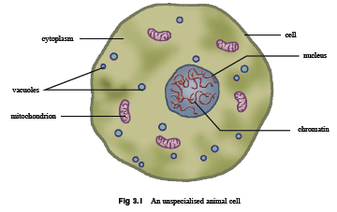
3.1 The Structure and Function of Plant and Animal Cells

Slide 4
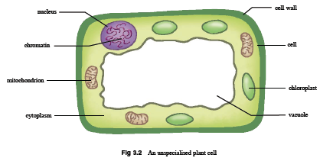
3.1 The Structure and Function of Plant and Animal Cells

Slide 5
3.1 The Structure and Function of Plant and Animal Cells
Structure of Unspecialised Plant and Animal Cell
Animal and plant cells have the following features in common:
• Cell membrane
• Cytoplasm
• Nucleus
• Vacuole
• Mitochondria

Slide 6
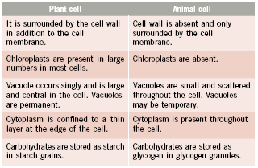
3.1 The Structure and Function of Plant and Animal Cells
Differences between plant and animal cells:

Slide 7
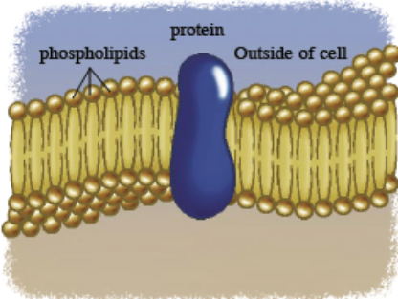
3.1 The Structure and Function of Plant and Animal Cells
Structure and Function of the Cell and Its Organelles
Cell membrane – a cell’s protective coat
It separates and protects a cell from its surrounding environment.
It consists of a double layer of phospholipids. Embedded within are other molecules such as proteins, that act as channels and pumps to move different molecules into and out of the cell.
It controls the movement of substances into and out of the cell and is said to be partially permeable.

Slide 8
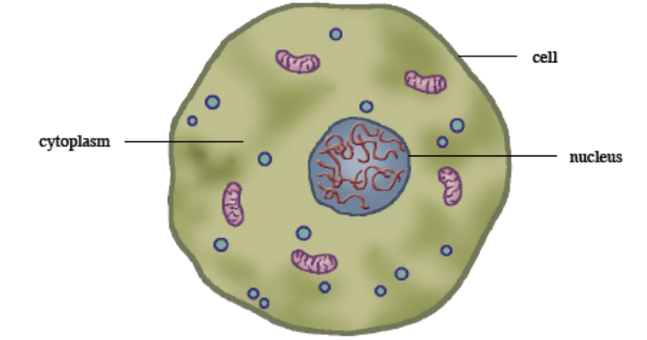
3.1 The Structure and Function of Plant and Animal Cells
Structure and Function of the Cell and Its Organelles
Cytoplasm – a cell’s inner space
It is the watery material between the nucleus and the cell membrane with a jelly-like consistency.
It contains mainly water and dissolved materials, allowing materials to move around the cell through a process called cytoplasmic streaming.
The function of the cytoplasm, and the organelles which reside in it, are critical for a cell’s survival.

Slide 9
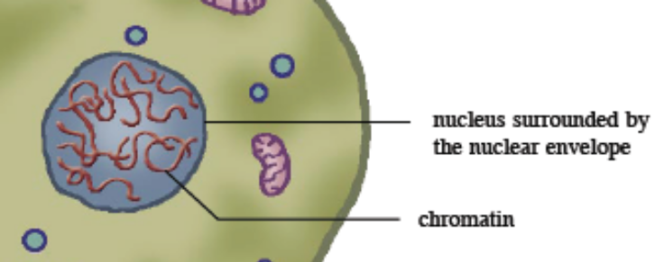
3.1 The Structure and Function of Plant and Animal Cells
Structure and Function of the Cell and Its Organelles
Nucleus – a cell’s centre
It is usually spherical, separated from the cytoplasm by a double membrane called the nuclear envelope.
It stores deoxyribonucleic acid (DNA), which is wound into structures called chromatin. DNA is the genetic material of an organism, carrying instructions for cell activities and heredity.
Its function therefore, is to protect the cell’s genetic material and control cell activities. It plays an important role in DNA replication and protein synthesis (see Chapter 20).

Slide 10
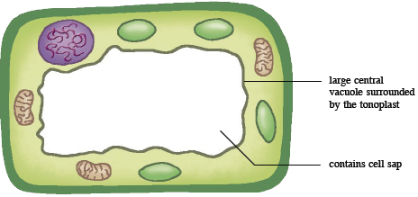
3.1 The Structure and Function of Plant and Animal Cells
Structure and Function of the Cell and Its Organelles
Vacuole – a cell’s storage space
In a plant cell, the vacuole is a permanent structure with a fixed shape, occupying a large central part of the cell. It is surrounded by a membrane (tonoplast) and contains cell sap, a solution of mineral salts and sugars.
Plant cells pump a lot of water into the vacuoles which expand and push against the cell wall. This creates a turgor pressure which is important to the plant to keep the cells turgid and thus provide support to the plant (see Chapter 4).

Slide 11
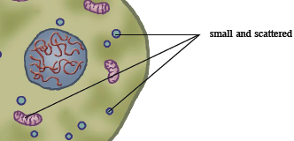
3.1 The Structure and Function of Plant and Animal Cells
Structure and Function of the Cell and Its Organelles
Vacuole – a cell’s storage space
In animal cells, the vacuoles are small and scattered throughout the cytoplasm. They are
temporary structures and are
membrane-bound sacs which have
various functions such as:
• transporting materials,
• storing sugars,
• containing digestive enzymes to digest invading bacteria,
• helping the cell to expel excess water.

Slide 12
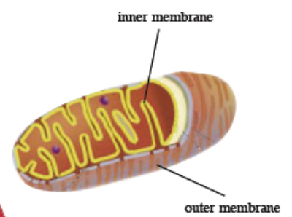
3.1 The Structure and Function of Plant and Animal Cells
Structure and Function of the Cell and Its Organelles
Mitochondria – a cell’s power generator
They are rod shaped and surrounded by a double membrane with an inner membrane extensively folded. They are sites of respiration (see Chapter 5) and are responsible for the release of energy which is subsequently stored in adenosine triphosphate (ATP) molecules.
Cells which have a high metabolic rate need a constant supply of energy. These cells, such as muscle and liver cells, contain a large number of mitochondria.

Slide 13
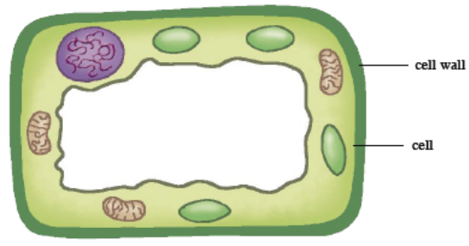
3.1 The Structure and Function of Plant and Animal Cells
Structure and Function of the Cell and Its Organelles
Cell wall – a plant cell’s extra armour
It is found only in plant cells; it is an extra layer of material in addition to the cell membrane.
Unlike the cell membrane, the cell wall is fully permeable. It is a rigid structure made up of cellulose and provides strength and shape to the cell.
It prevents the plant cell from bursting when too much water enters the vacuole
(see Chapter 4).

Slide 14
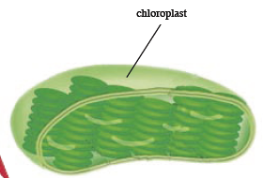
3.1 The Structure and Function of Plant and Animal Cells
Structure and Function of the Cell and Its Organelles
Chloroplasts – a plant cell’s solar generator
They are similar to mitochondria but are found only in plant cells which photosynthesise. They are flat discs, surrounded by a double membrane called the chloroplast envelope.
They are usually green in colour because of a pigment called chlorophyll. During photosynthesis, chloroplasts trap light energy from the Sun and energy is stored in ATP (see Chapter 15).

Slide 15
3.2 Cell Specialisation in Multicellular Organisms
You should be able to:
■ explain the importance of cell specialisation; and
■ differentiate between cell, tissue, organ and organ system.

Slide 16
3.2 Cell Specialisation in Multicellular Organisms
Cell Specialisation
Multicellular organisms are composed of several different types of cells; each cell is differently adapted to perform a specific function.
As the cells are produced and developed, they change their structure in some ways to specialise in a specific function.
This process of development is known as cell differentiation.

Slide 17
3.2 Cell Specialisation in Multicellular Organisms
Examples of specialised cells in plants and animals:
Xylem vessels
• are pipe-like columns;
• provide support;
• transport water and mineral salts from roots to other parts.

Slide 18
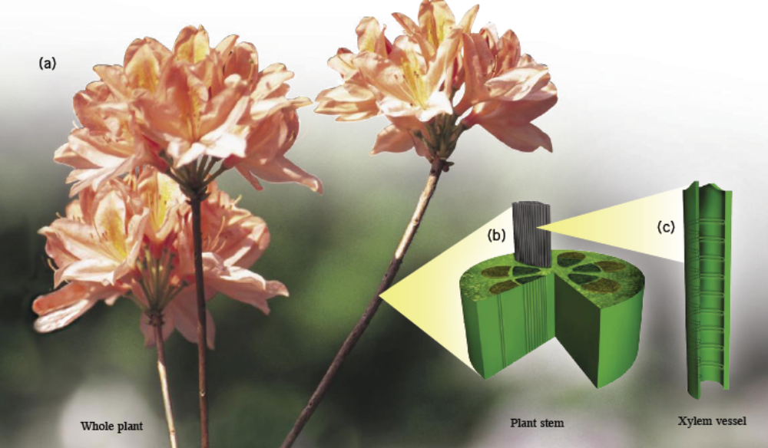
3.2 Cell Specialisation in Multicellular Organisms
Xylem Vessels

Slide 19
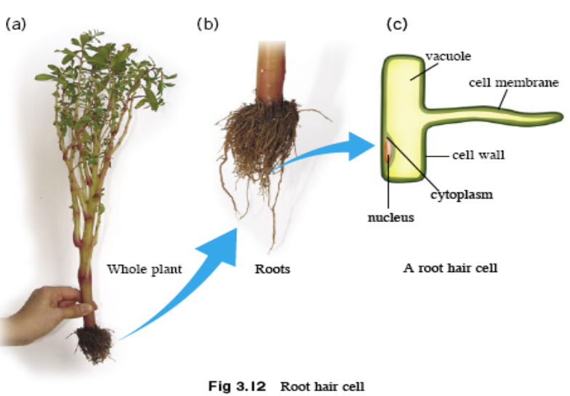
3.2 Cell Specialisation in Multicellular Organisms
Examples of specialised cells in plants and animals:
Root hair cell
• has a long narrow extension of the cell;
• has a large surface area to volume ratio;
• increases the rate of
diffusion of water
and mineral salts.

Slide 20
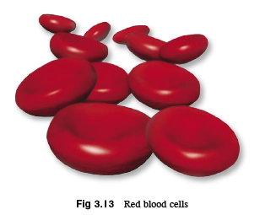
3.2 Cell Specialisation in Multicellular Organisms
Examples of specialised cells in plants and animals:
Red blood cells
• supply oxygen to other body cells;
• contain red pigment called haemoglobin – combine easily with oxygen;
• do not have nucleus – can pack more haemoglobin;
• are biconcave shaped – increase surface area;
• have an elastic cell membrane – allows them to be squeezed through narrow cap

Slide 21
3.2 Cell Specialisation in Multicellular Organisms
Cell Organisation
Some organisms, such as bacteria, are unicellular, consisting of a single cell. Other organisms, such as humans, are multicellular, or have many cells − an estimated 100,000,000,000,000 cells!
Multicellular organisms are composed of several different types of cells organised into organ systems which work with one another to ensure that the whole organism functions effectively.

Slide 22
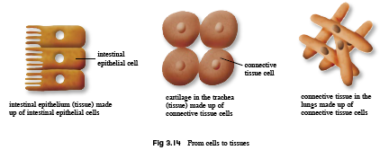
3.2 Cell Specialisation in Multicellular Organisms
Cell Organisation
The different levels of organisation are as follows:
1. Similar cells work together as tissues to carry out a particular function.

Slide 23
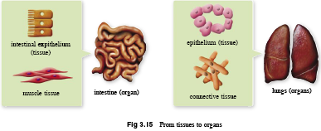
3.2 Cell Specialisation in Multicellular Organisms
2. Different tissues work together as an organ to carry out a particular function.

Slide 24
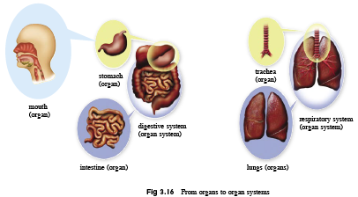
3.2 Cell Specialisation in Multicellular Organisms
3. Different organs work together as an organ system to carry out a particular function.

Slide 25
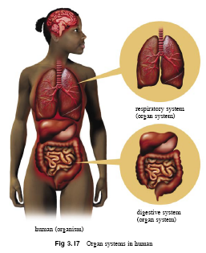
3.2 Cell Specialisation in Multicellular Organisms
4. An organism consists of several organ systems with each carrying out its own function.

Slide 26
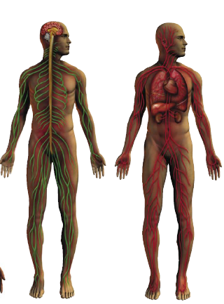
3.2 Cell Specialisation in Multicellular Organisms
Other systems include the:
respiratory system,
circulatory system,
nervous system,
digestive system,
excretory system,
musculo skeletal system, and
reproductive system.

Slide 27
3.2 Cell Specialisation in Multicellular Organisms
Cell Organisation
Plants are also multicellular organisms.
Epidermal cells make up the epidermal tissue. Xylem cells and phloem cells make up the vascular tissue. Many other cells of the cortex and pith make up the supporting tissue of the stems.
These different plant tissues group together to form the plant organs – the roots, leaves and flowers.
The different organs make up the organ systems of the plant – the roots or shoots system.

Slide 28
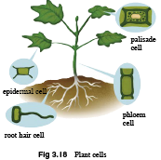
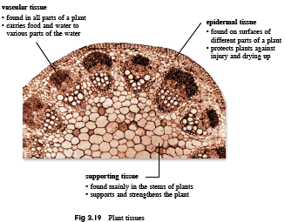

Slide 29
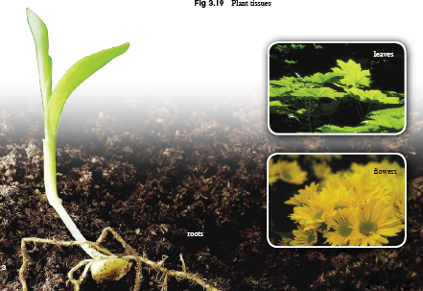
Fig 3.20: Plant organs

Slide 30
Key Concepts
Cell structure and organelles
All plant and animal cells have a cell membrane made up of proteins and phospholipids, cytoplasm, a nucleus which contains deoxyribonucleic acid (DNA) and rod-shaped structures involved in respiration called mitochondria.
Plant cells are also surrounded by a cell wall which is made up of cellulose. The cell wall is fully permeable unlike the cell membrane which is partially permeable. The cell membrane controls the movement of substances into and out of the cell.

Slide 31
Key Concepts
Cell structure and organelles
Plant cells are occupied by a large central vacuole which contains a solution of salts and sugars called cell sap. This vacuole is surrounded by a membrane known as the tonoplast.
Animal cells may also contain vacuoles; however they are smaller and scattered throughout the cytoplasm.
Chloroplasts are found in plant cells which photosynthesise. They contain a pigment called chlorophyll.

Slide 32
Key Concepts
Cell specialisation and organisation
Cells become specialised in structure to perform a specific function in a process called cell differentiation.
Similar cells work together as a tissue to carry out a particular function.
Different tissues work together as an organ to carry out a particular function.
Different organs work together as an organ system to carry out a particular function.
A multicellular organism is made up of many organ systems working together.

